Slide 1
Automaton Theories of Human Sentence Comprehension - Ch. 7: Information-Theoretical Complexity Metrics
2020. 03. 18
Won Ik Cho
Notes:
.

Slide 2
Previous approaches
Experience might guide a parsing mechanism
Reinforcement learning / Informed search
Associated with an experience-based estimate of distance from completion
Relatively concrete
Could be put in correspondence with observed difficulty measures
But how about other direction?
e.g., Starting with an abstract characterization of difficulty itself and Building a mechanical model consistent with the characterization?

Slide 3
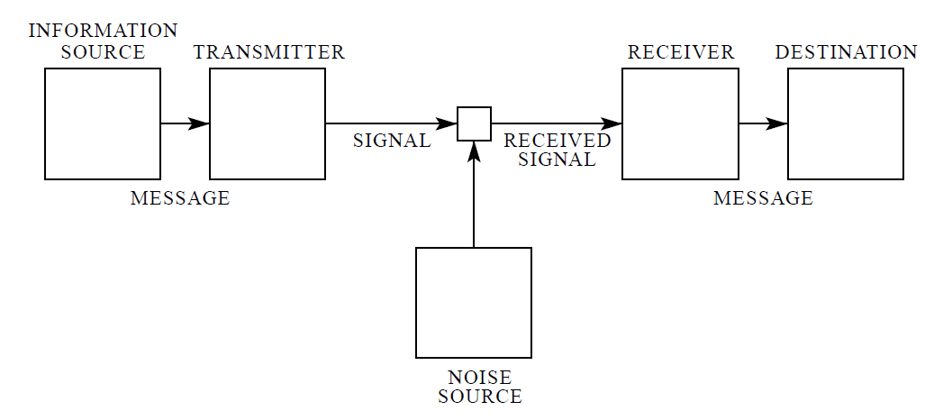
Information theory
Information theory in sense of Shannon (1948)
Shannon, C. E., 1948, A Mathematical Theory of Communication
Mathematical formulation on information, channel, transmission, receiving, noise, encoding and decoding
Information theoretical interpretation of ‘entropy’
About self-information (wiki!)
An event with probability 100% is perfectly unsurprising and yields no information
The less probable an event is, the more surprising it is and the more information it yields
If two independent events are measured separately, the total amount of information is the sum of the self-informations of the individual events

Slide 4
Probabilistic grammar
Information theory in sense of Shannon (1948)
How we adopt this here?
Surprisal (Hale 2001; Levy 2008)
Entropy reduction (Hale 2003, 2006; Yun et al., 2015)
Here, historical backgrounds are managed
Relationship with probabilistic grammar (PG)
Information theory = Logarithmic probability theory?
Not just a jest!
Important to have a sense of how probability can apply to generative grammar
Basic idea
Extend formal grammars so that the ‘objects’ they derive are metaphorically ‘weighted’
Weight is typically a number
If these weights satisfy the axioms of probability theory?

Slide 5
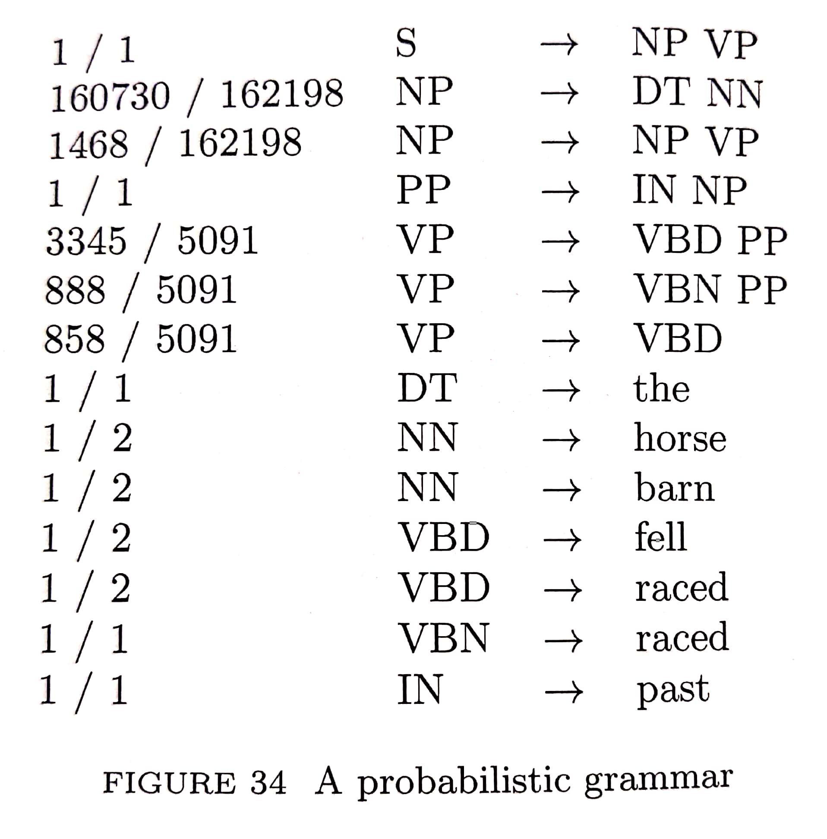
Probabilistic grammar
Relationship with probabilistic grammar (PG)
Basic idea (cont’d)
What if the weights of derived strings add up to 1.0?
Suppes (1970)
Weighted formal languages could be viewed as hypotheses about the distribution of utterances in a real human language
... connects generative grammar to the quantitative linguistic tradition
How to define a probabilistic grammar?
Simplest one: To augment each rewriting rule with a probability
>> ratios that have been directly off the TreeBank (PTB)
e.g., for NP -> DT NN,
denominator: # NP appeared
numerator: # NP comes with daughters as DT and NN

Slide 6
Probabilistic grammar
Relationship with probabilistic grammar (PG)
Probability of any given derivation on a probabilistic grammar
... is simply the product of the probabilities of all the rules that were applied in that derivation
If sentence ambiguous
>> Grammar assigns more than one derivation
>> Total probability of the sentence is the sum of prob.s of all the derivations
But...
Preceding discussion casts PG as things that assigns prob.s to derivations
For a given sentence, defined:
Whether or not there exist any derivations for that sentence
If there are, what prob. goes with each of those derivations
How about extending this to the case of initial sentence fragments?

Slide 7
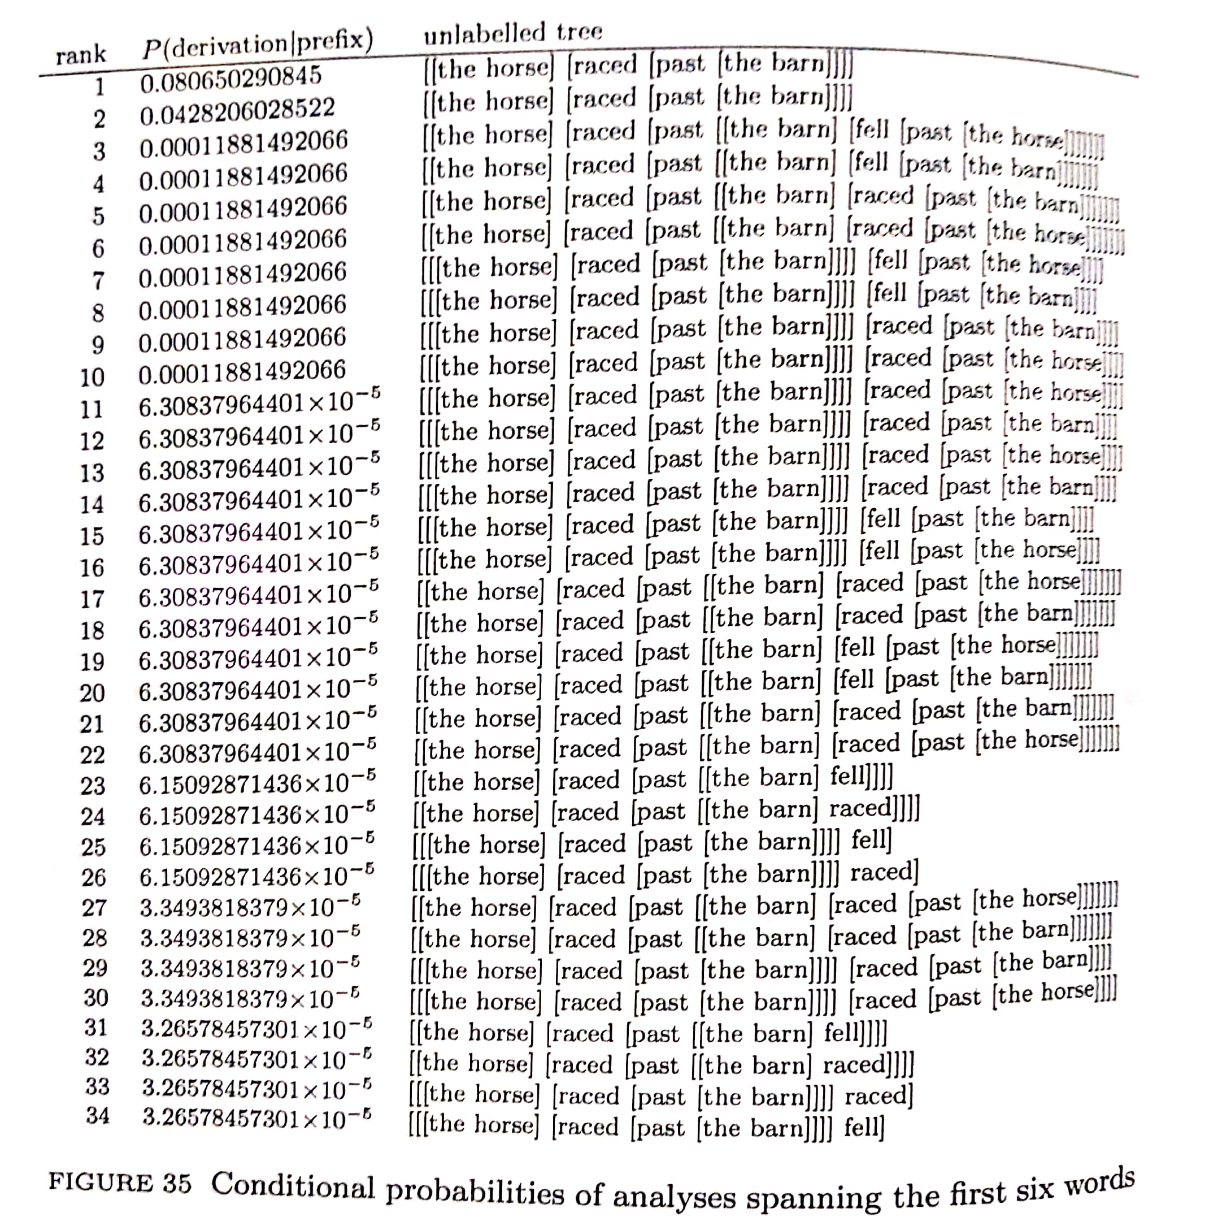
Probabilistic grammar
Relationship with probabilistic grammar (PG)
Initial sentence fragments
Of interest:
Which derivations are compatible with a sequence of words that begin
Not necessarily
What ends a well-formed sentence
The weights assigned by PG encode a set of grammar-based expectations about anticipated words
e.g., the situation by enumerating derivations that are consistent with the initial substring “the horse raced past the barn” (already been heard)
Longer derivations involve more rules
More multipl.s by numbers <1
But still, overwhelming expectation at word `barn’ for the sentence to be over
Grammatically right < lowest!

Slide 8
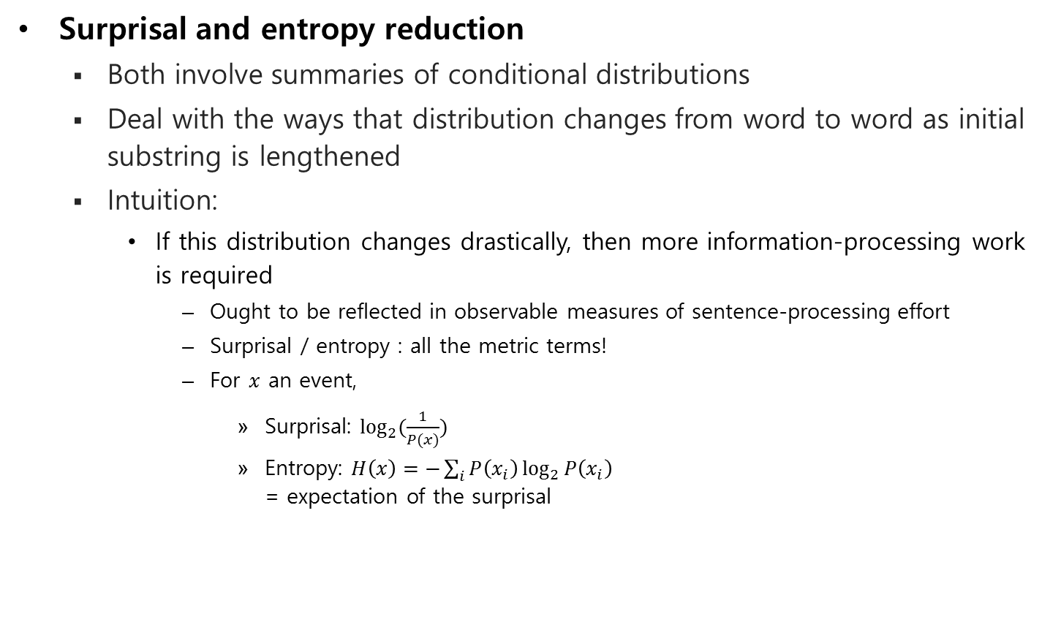
Conditional distribution
Surprisal and entropy reduction
Both involve summaries of conditional distributions
Deal with the ways that distribution changes from word to word as initial substring is lengthened
Intuition:
If this distribution changes drastically, then more information-processing work is required
Ought to be reflected in observable measures of sentence-processing effort
Surprisal / entropy : all the metric terms!
For $x$ an event,
Surprisal: $\log_{2}{(\frac{1}{P(x)})}$
Entropy: $H\left(x\right)=−\sum_{i}{P\left(x_{i}\right)\log_{2}{P\left(x_{i}\right)}}$ = expectation of the surprisal

Slide 9
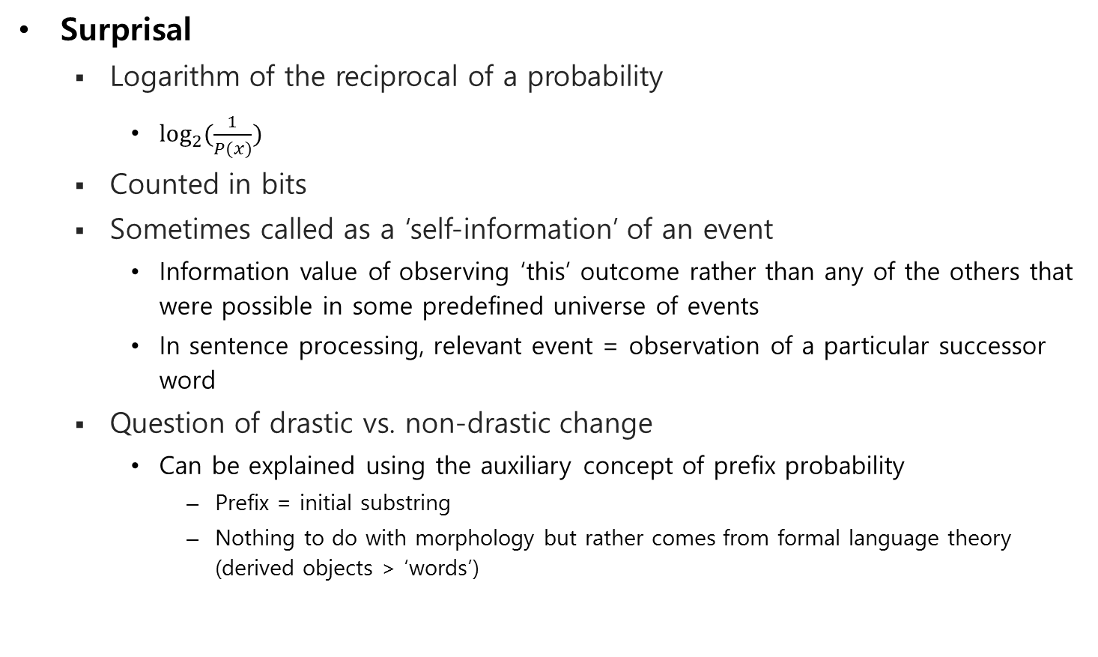
Conditional distribution
Surprisal
Logarithm of the reciprocal of a probability
$\log_{2}{(\frac{1}{P(x)})}$
Counted in bits
Sometimes called as a ‘self-information’ of an event
Information value of observing ‘this’ outcome rather than any of the others that were possible in some predefined universe of events
In sentence processing, relevant event = observation of a particular successor word
Question of drastic vs. non-drastic change
Can be explained using the auxiliary concept of prefix probability
Prefix = initial substring
Nothing to do with morphology but rather comes from formal language theory (derived objects > ‘words’)

Slide 10
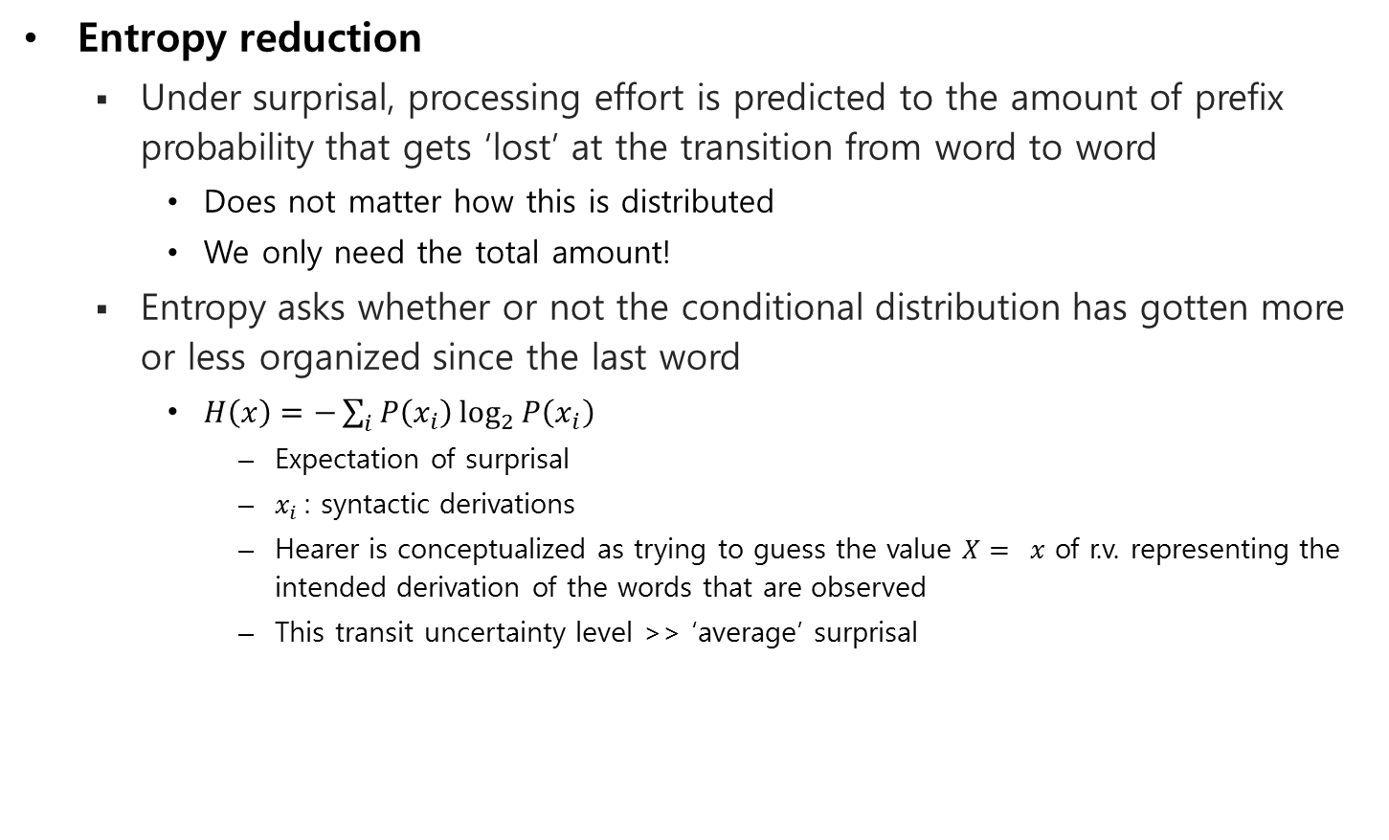
Conditional distribution
Entropy reduction
Under surprisal, processing effort is predicted to the amount of prefix probability that gets ‘lost’ at the transition from word to word
Does not matter how this is distributed
We only need the total amount!
Entropy asks whether or not the conditional distribution has gotten more or less organized since the last word
$H\left(x\right)=−\sum_{i}{P\left(x_{i}\right)\log_{2}{P\left(x_{i}\right)}}$
Expectation of surprisal
$x_{i}$: syntactic derivations
Hearer is conceptualized as trying to guess the value $X= x$ of r.v. representing the intended derivation of the words that are observed
This transit uncertainty level >> ‘average’ surprisal

Slide 11
Surprisal and entropy reduction
Empirical support
Hale (2001)
Garden path sentences and different types of relative clauses
Later...
Broad coverage of sentences
Eye-tracking data and neural signals (from magnetic resonance imaging)
Two general reasons for the productivity of the research
Combinability of information-theoretical complexity metrics with essentially any model of language
Frank (2013) – RNN
Park and Brew (2006) and Levy (2013) – Surprisal values from finite-state Markov models
Hale (2006) and Yun et al. (2015) – Formalization of minimalism
Sometimes, the data and complexity metric are not enough to decide btw alternative linguistic proposals!
The fact that frequency effects are among the most robust in all of psycholinguistics
Surprisal and entropy - based on conditional distributions thus can capture some syntactic effects given that the probabililistic model is grammar-based

Slide 12
Surprisal and entropy reduction
Difference
Entropy reduction
Motivated by the failure of surprisal
In combination with context-free phrase structure grammars
Hale (2003):
Account as a more empirically-adequate replacement for surprisal
Builds on the different potential for recursive modification across subject- and object-extracted relative clauses
But whether the full range of phenomena can be subsumed in one theory still remains open!

Slide 13
Thank you!
EndOfPresentation

